Slide 1
Microsoft Teams video conferencing
A guide to your interview meeting on Teams
This guide will take you through how to join your video interview meeting

Slide 2
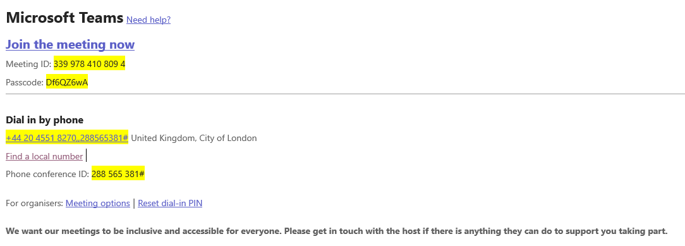
Step 1: locate and click on the link
What it will look like:
Click on the link on your email invite that says
Join the meeting now
Anything in yellow: these will be different from meeting to meeting

Slide 3
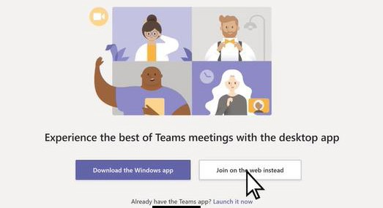
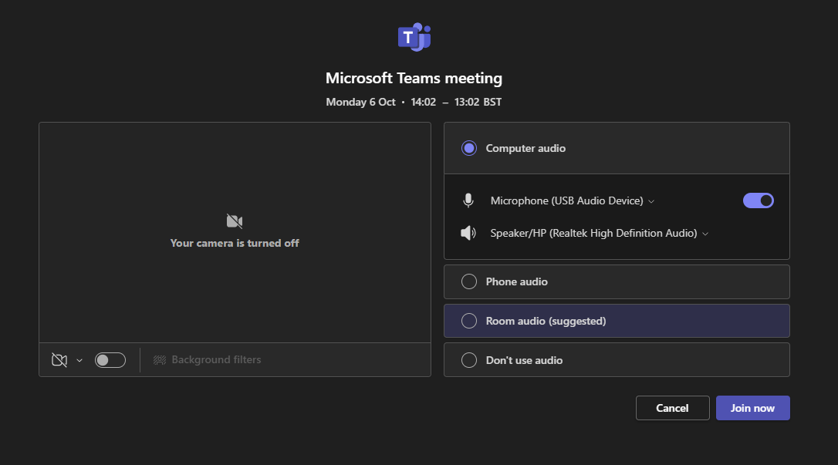
Step 2: open in your web browser or Teams app
What it will look like:
If presented with a screen that asks you to pick if you want to join through a web browser or use through the Teams app, it is completely down to your preference.
After this, you will be presented with a screen either the same or similar to Image 2
Image 1
Image 2

Slide 4
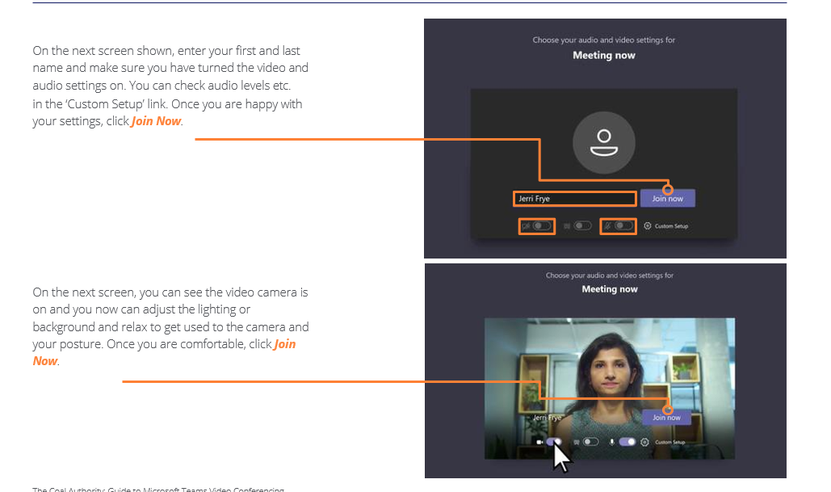
Step 3: Make sure you are ready to join
Follow this step if you are joining
through your web browser
If you are joining via the Teams app, please move to the next slide

Slide 5
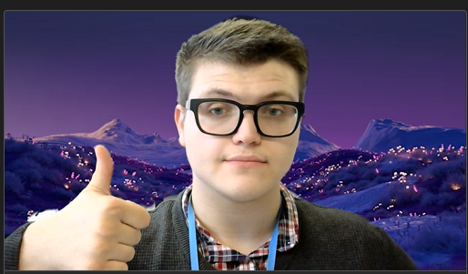

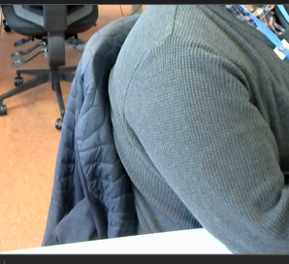
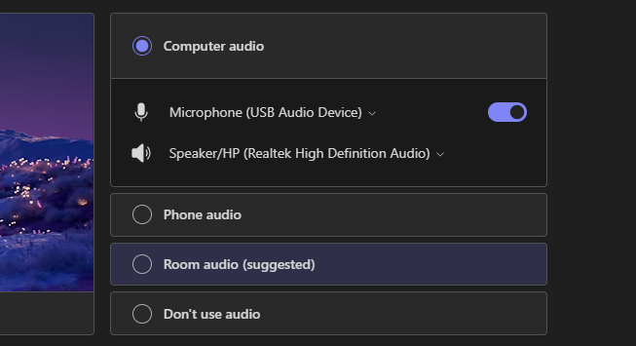

Step 3: Make sure you are ready to join
Follow this step if you are joining
through the Teams desktop app
Make sure your camera is on
(or off if required)
Make sure you have your background on, if needed
Make sure your posture is correct and the lighting is right
Don’t forget
Get your notes ready and feel free to make notes throughout
Get yourself a hot or cold drink ready for the meeting
Make sure your microphone is on (or off if required)
Once you are ready, click the Join now button

Slide 6
Step 4: waiting for the host
Waiting for your host
You are now waiting in a lobby. The meeting host knows you are waiting. Wait for them to let you in.

Slide 7
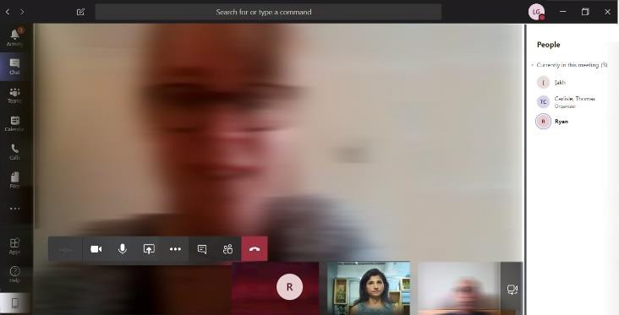
Step 5: you’ve been invited in
Once the host invites you in, you will see a similar screen to the one on the right, with other attendees. You can also adjust settings in this panel if you wish to.

Slide 8
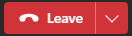
Step 6: the final step
Have the call/meeting, then end the call
Once the interview has come to an end and the host has confirmed the end of the meeting - please make sure you click on the red phone icon to end the meeting.

Slide 9
Thank you

